Slide 1


Cloud Foundations and Essentials
Facilitator : Dr. Suman Mathur
Steps to Create Load Balancer

Slide 2
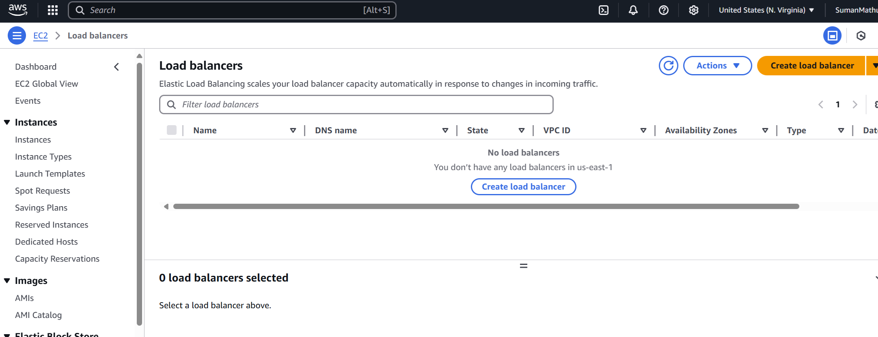
Step 1 : Click on Load Balancer

Slide 3
Step 2 : Click on Create Load balancer

Slide 4
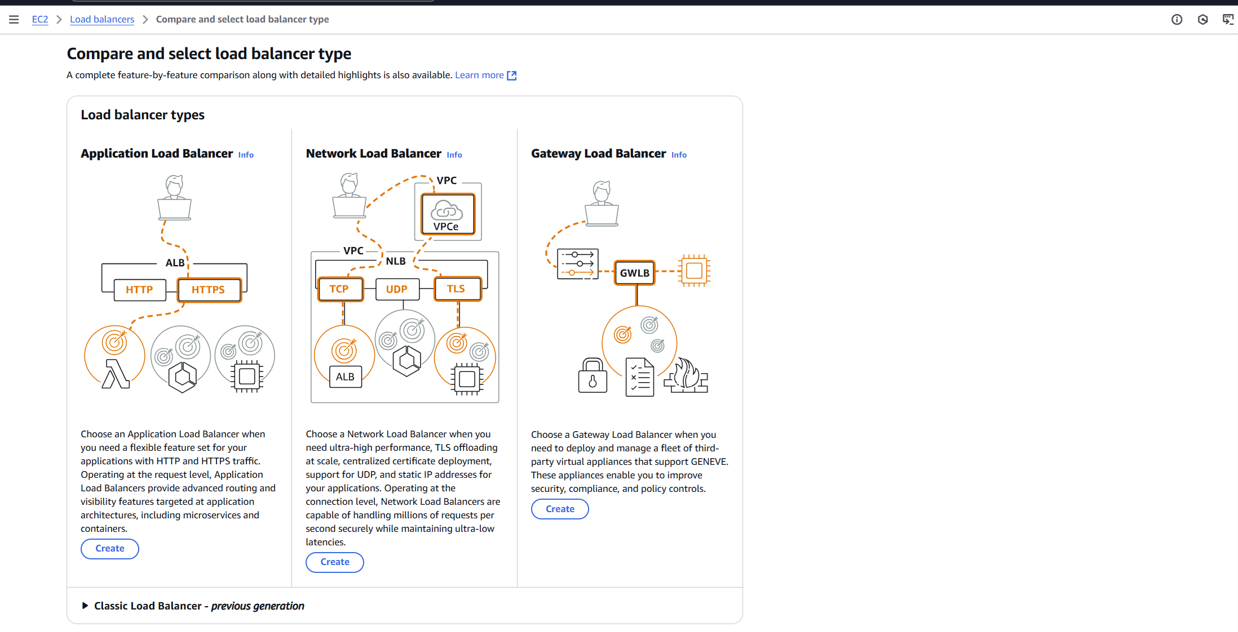
Step 3 : Select Load balancer type
Application Load Balancer (ALB)

Slide 5
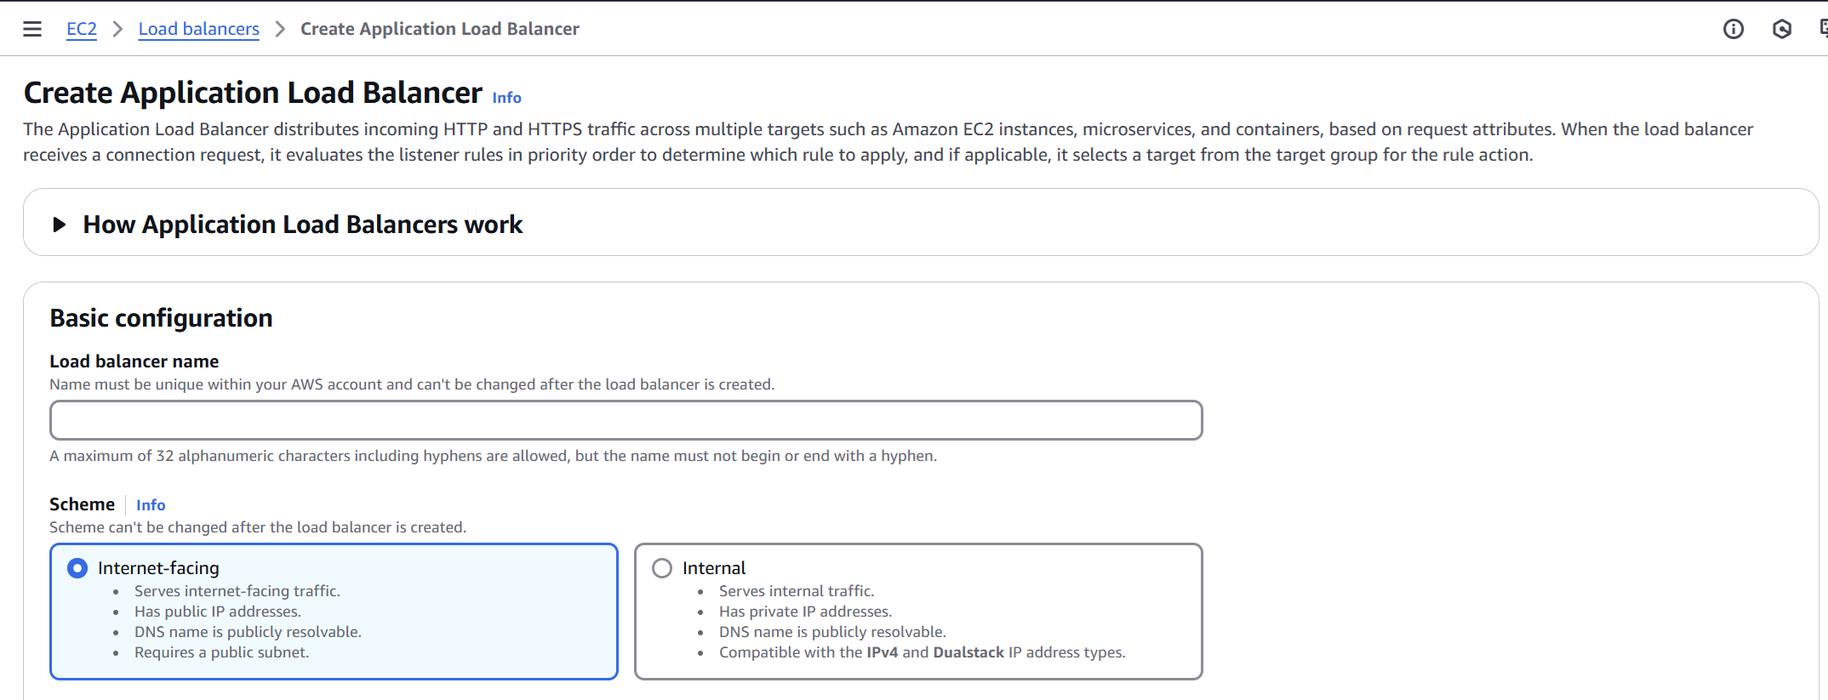
Step 4 : Enter Balancer name

Slide 6
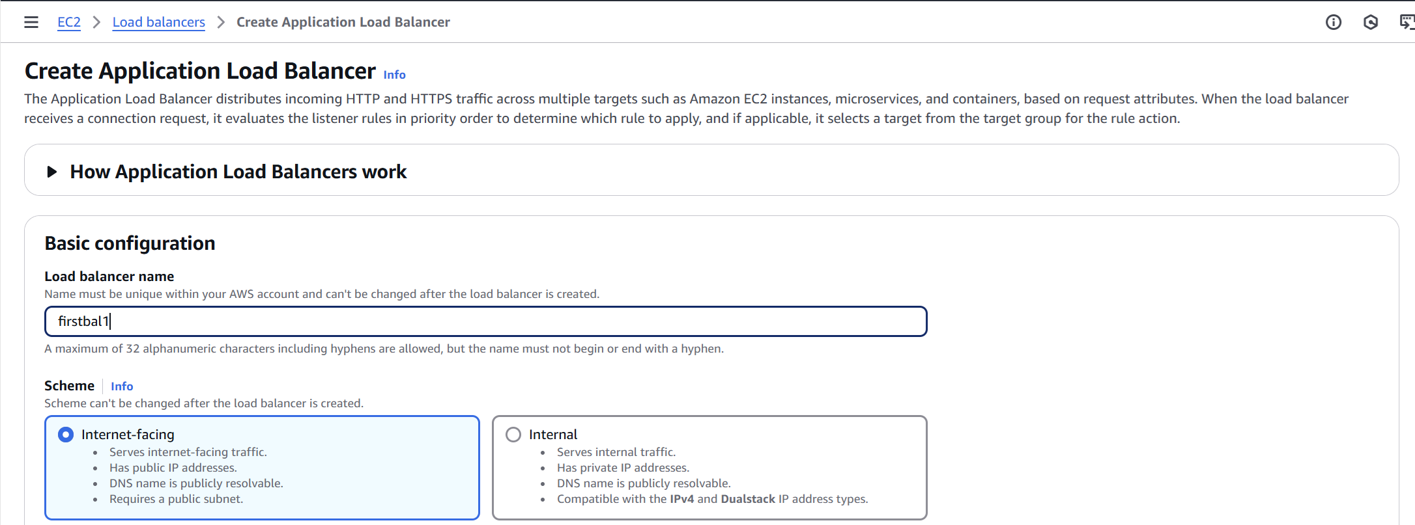
Step 5 : Balancer name

Slide 7
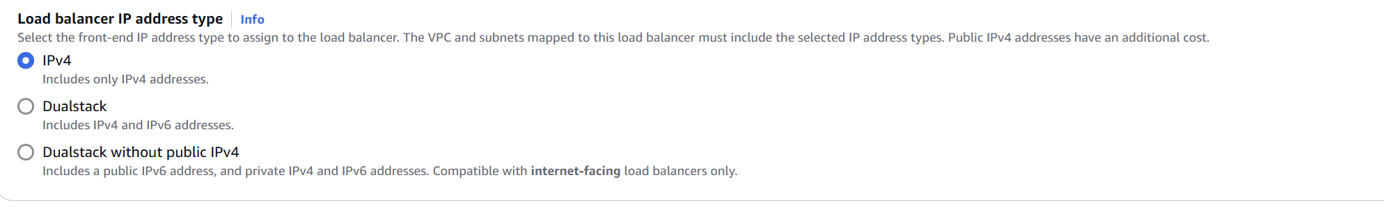
Step6 : Select IPV4

Slide 8
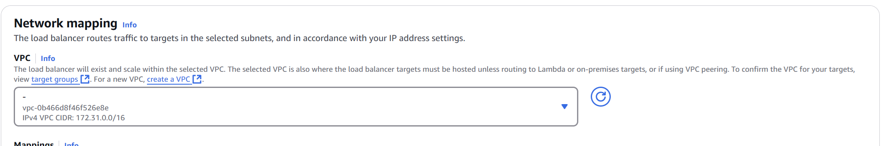
Step7: Default selection , if only one instance is there. Otherwise select from the dropdown list.

Slide 9
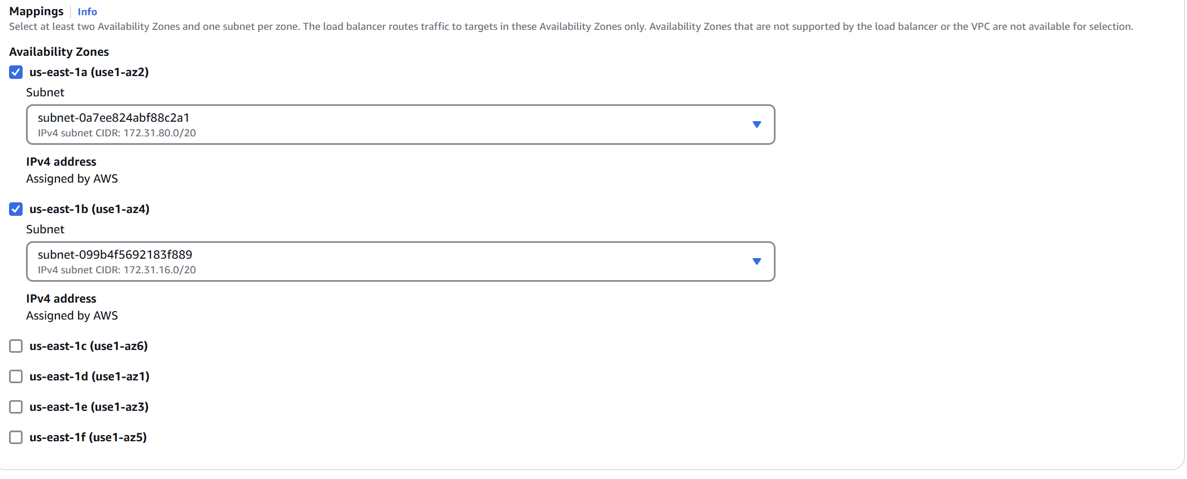
Step8: Scroll down for the other settings
Select at least any two zones

Slide 10
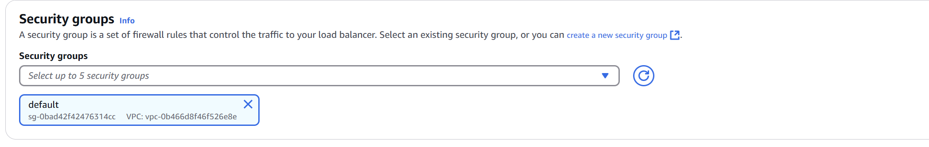
Step9: Security group automatically selected

Slide 11
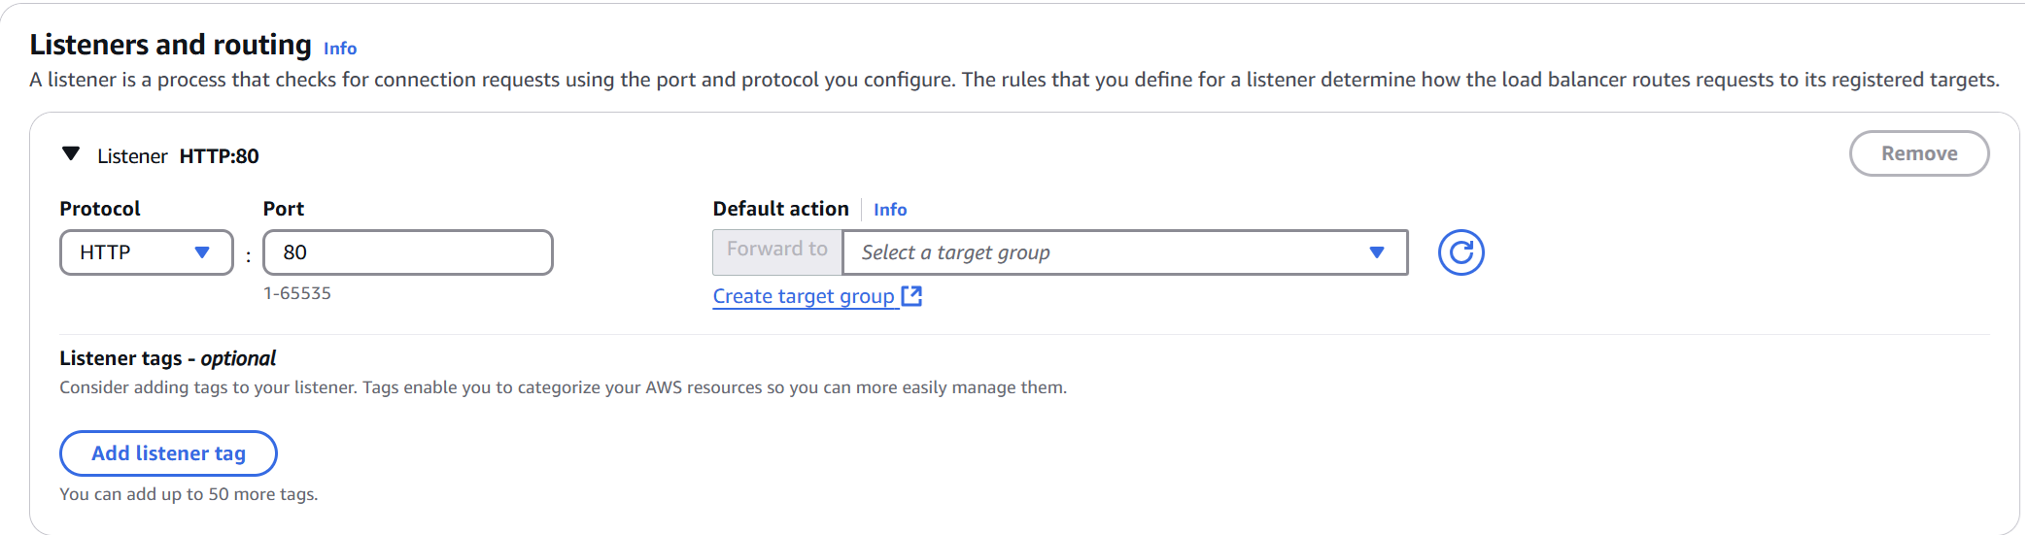
Step10: Create Target Group

Slide 12
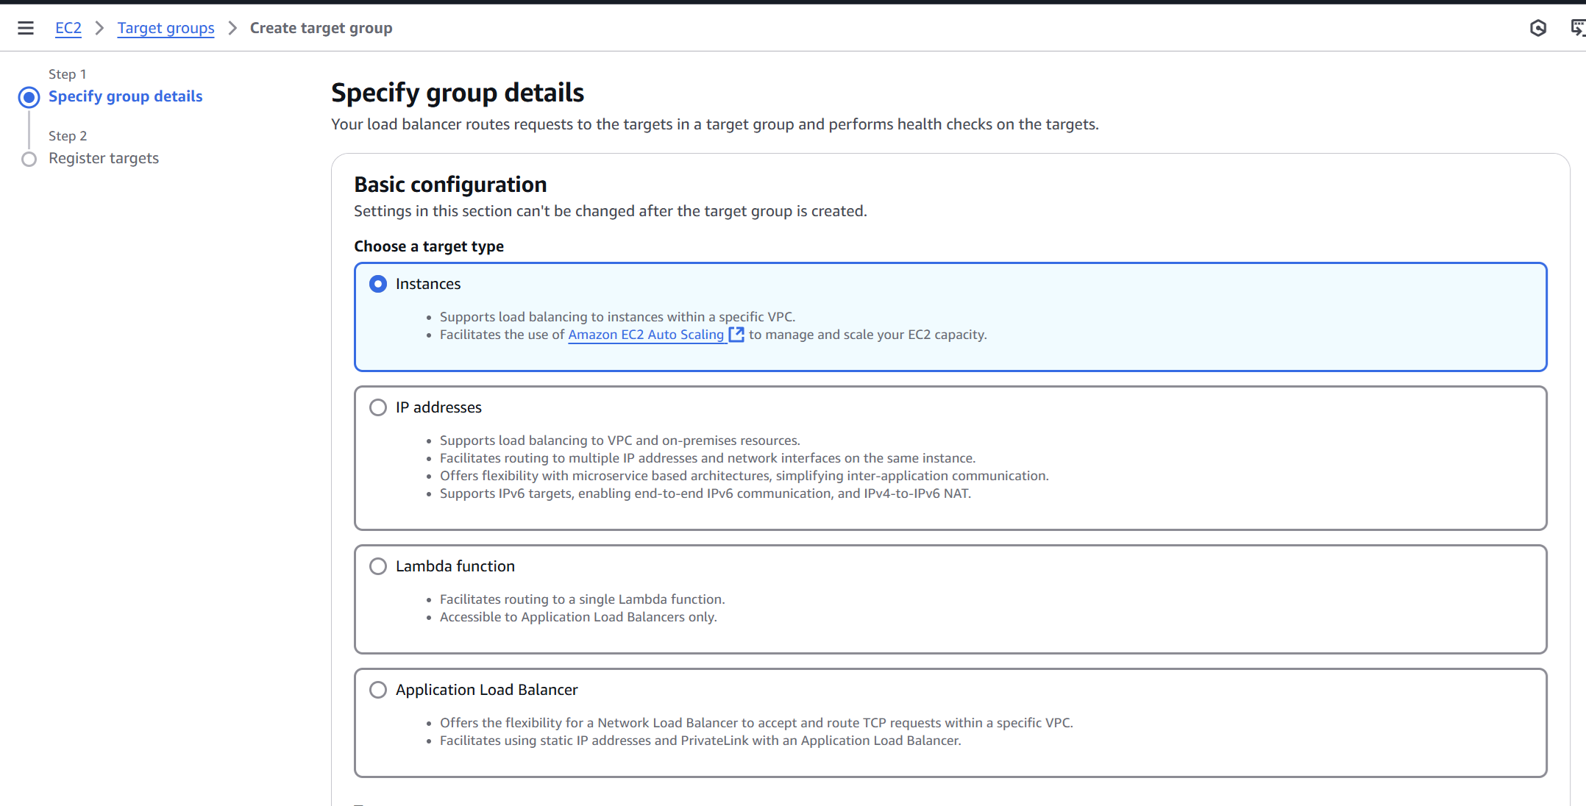
Step11: Select Instance

Slide 13
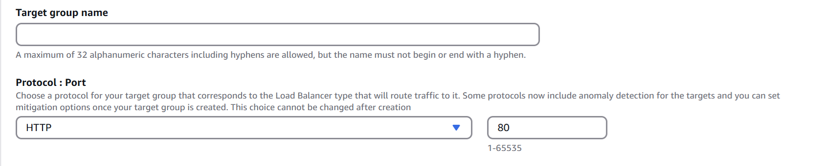
Step12: Enter Target group name

Slide 14
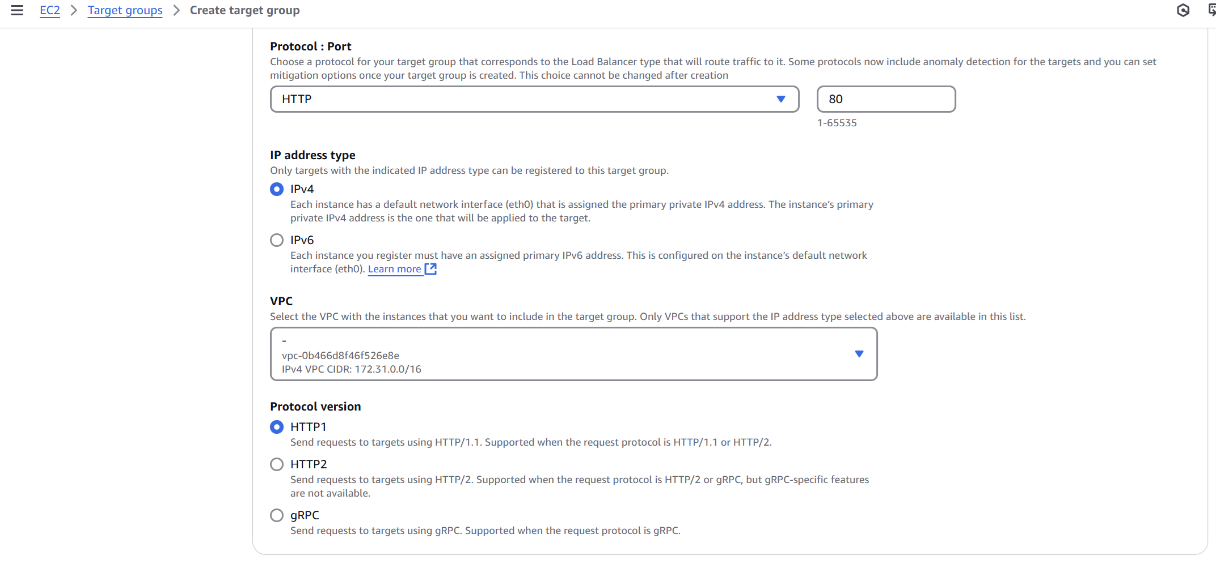
Step13: Select settings

Slide 15
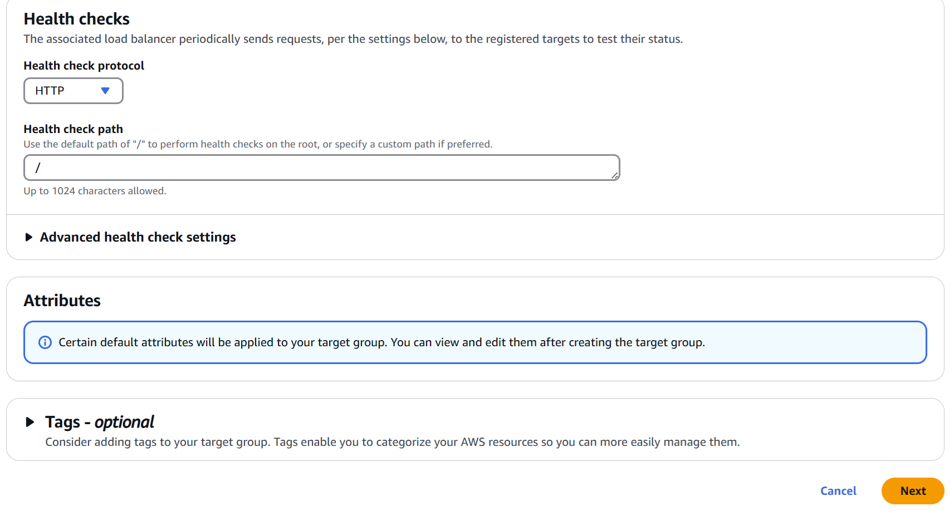
Step14: Apply Settings and click on Next
index.html

Slide 16
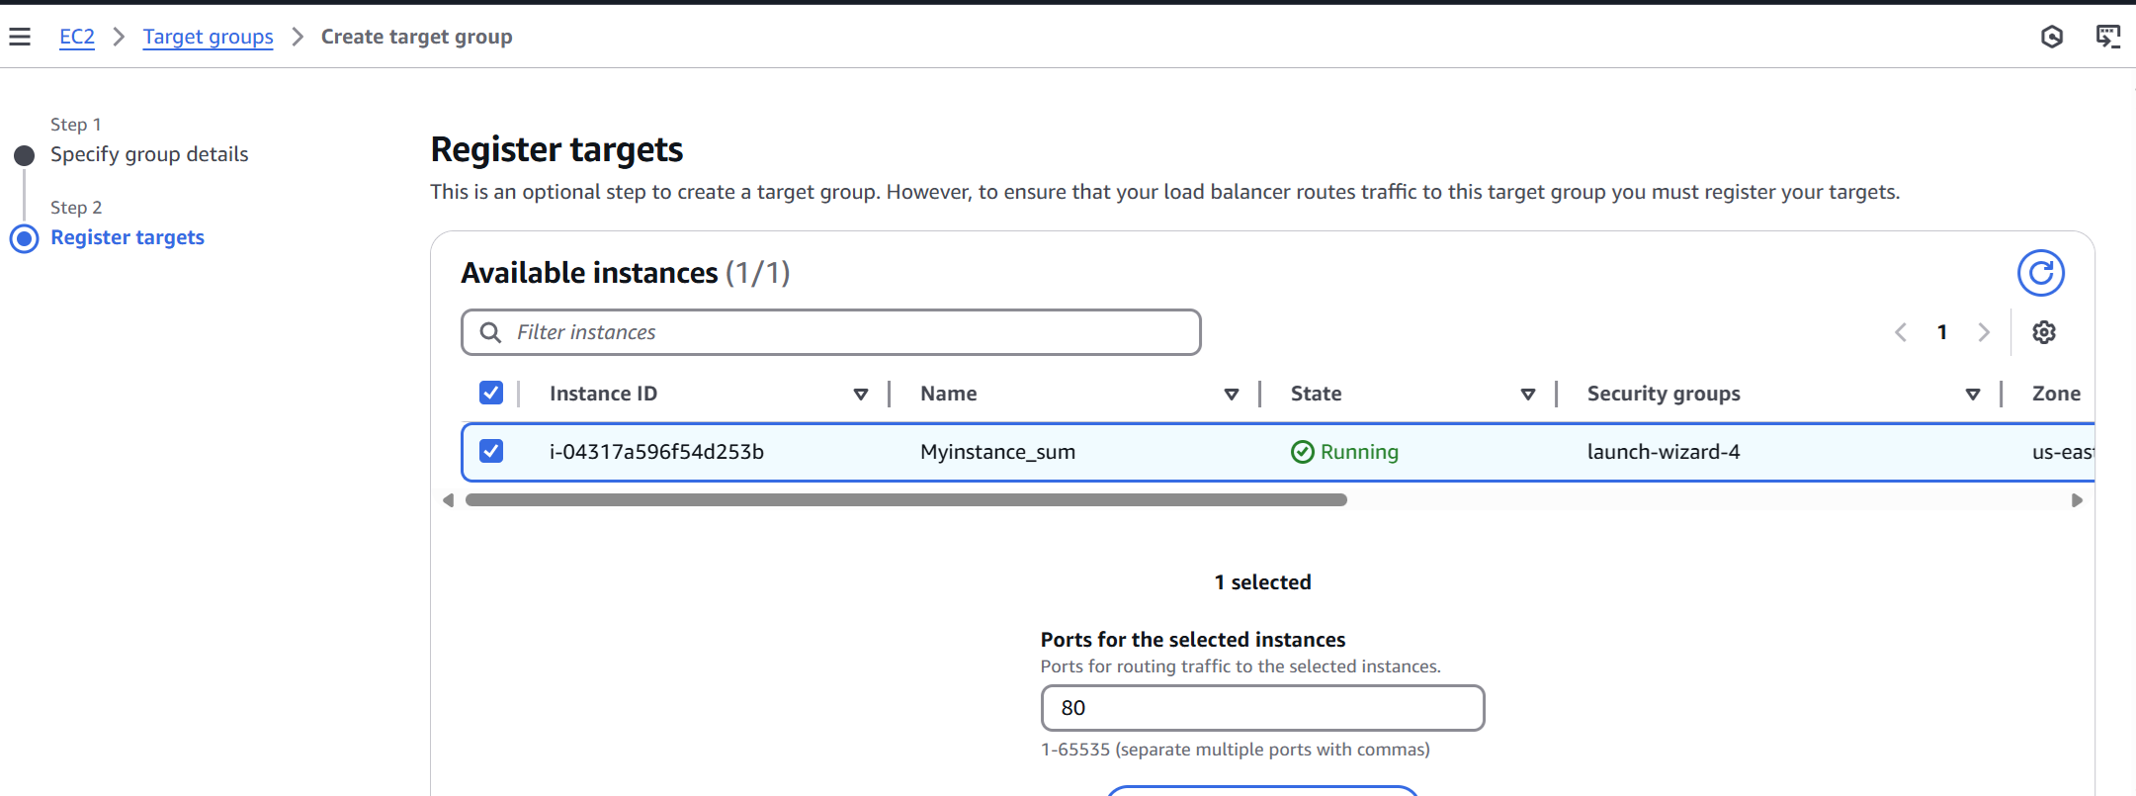
Step15: Select instances to receive traffic

Slide 17
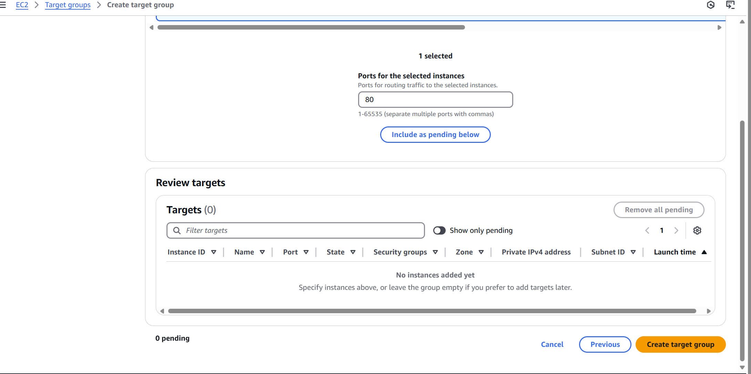
Step16: Click on target group

Slide 18
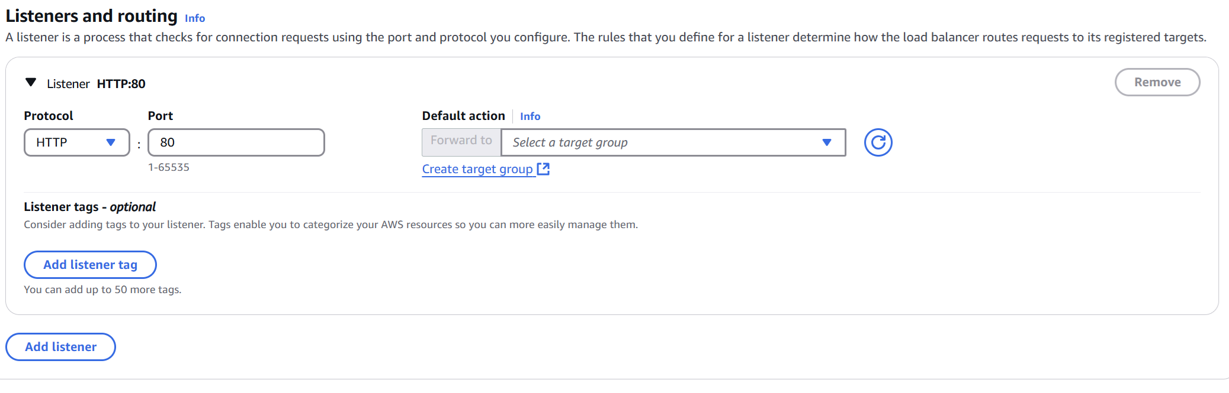
Step17: Select target group bay clicking on list

Slide 19
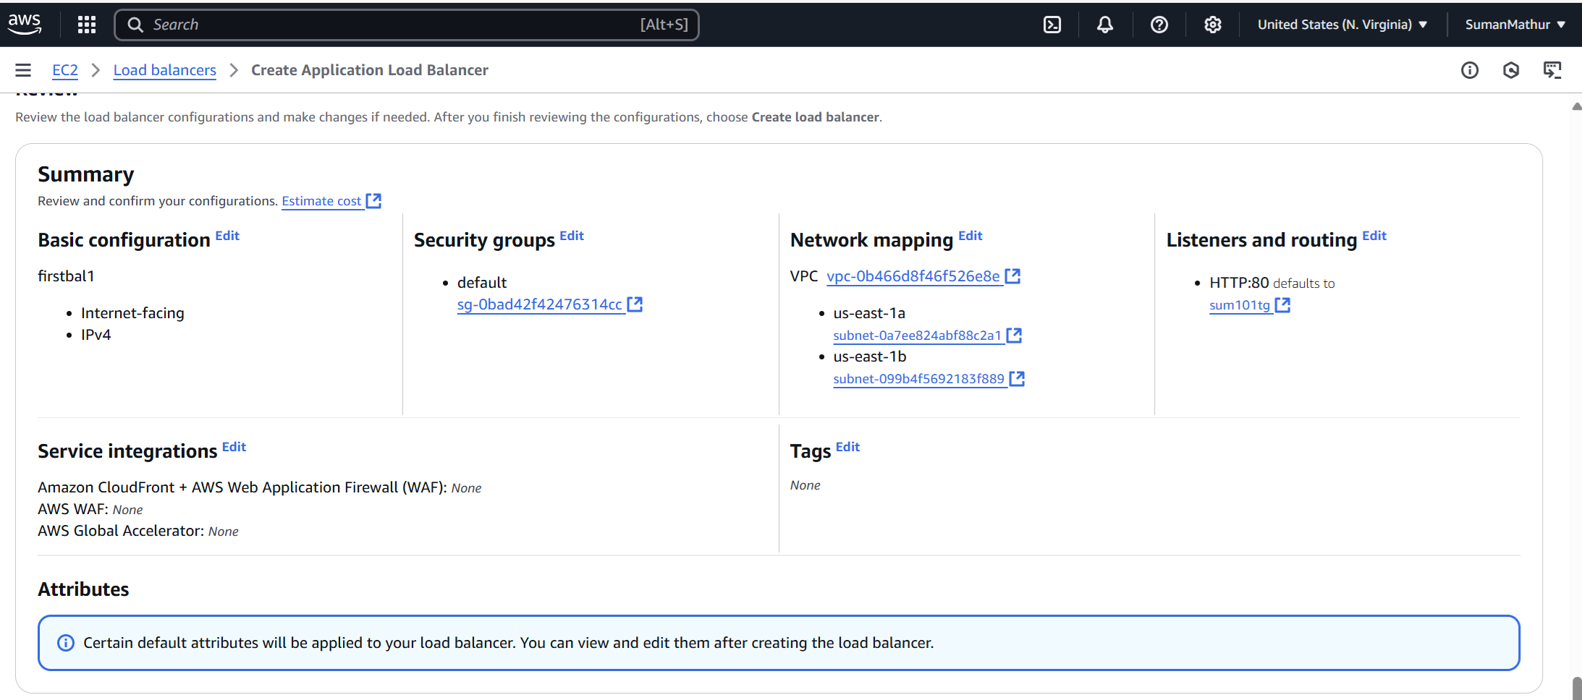
Step18: Summary screen

Slide 20
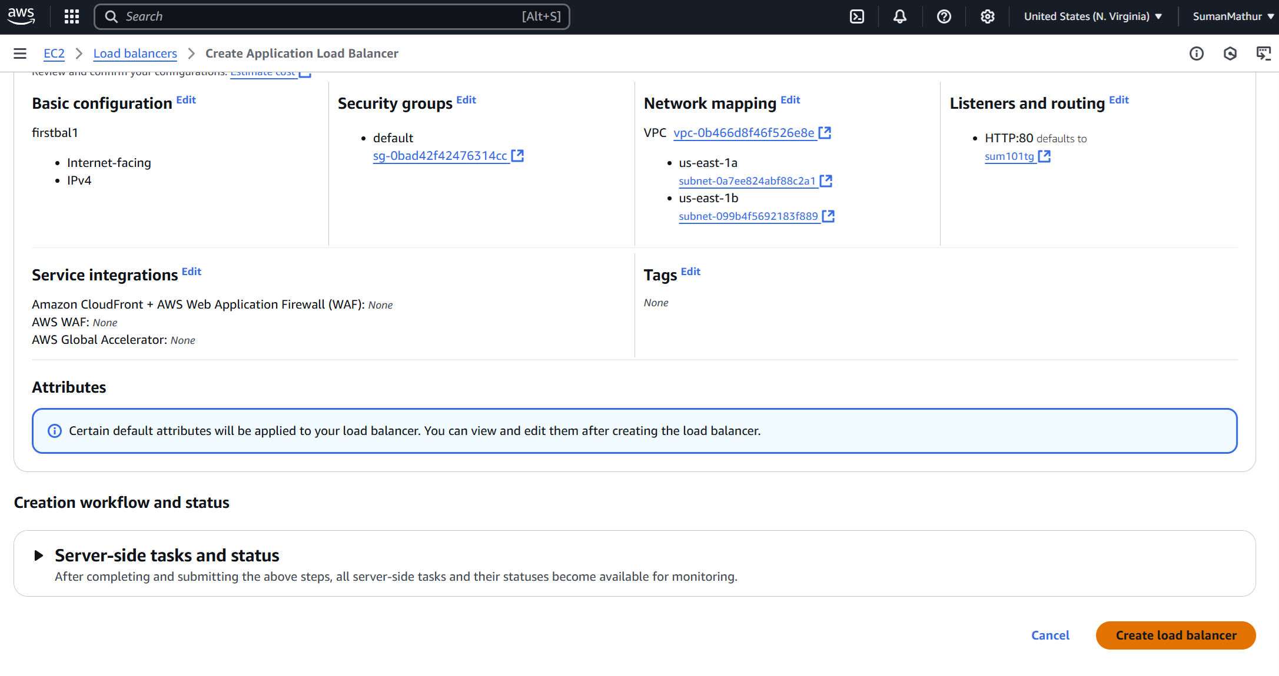
Step19: Click on Create load balancer

Slide 21
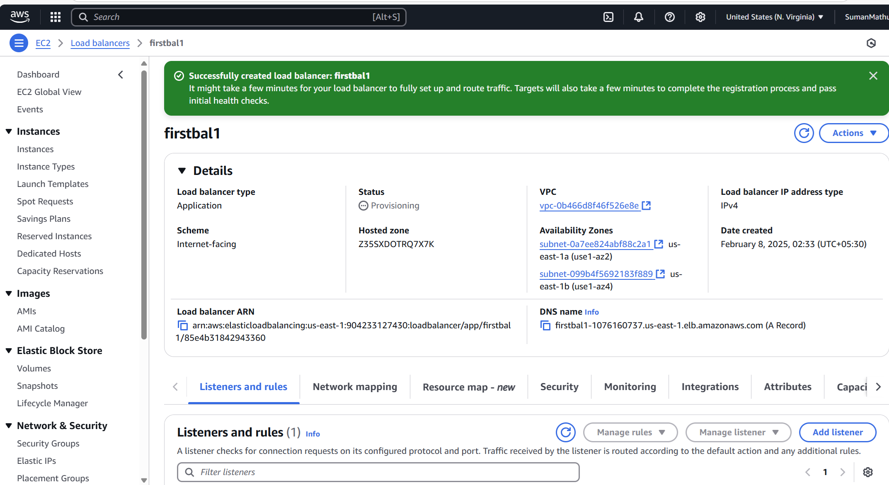
Step20: Successfully created

Slide 22
Step21: Copy DNS and go to Load balancer in EC2

Slide 23
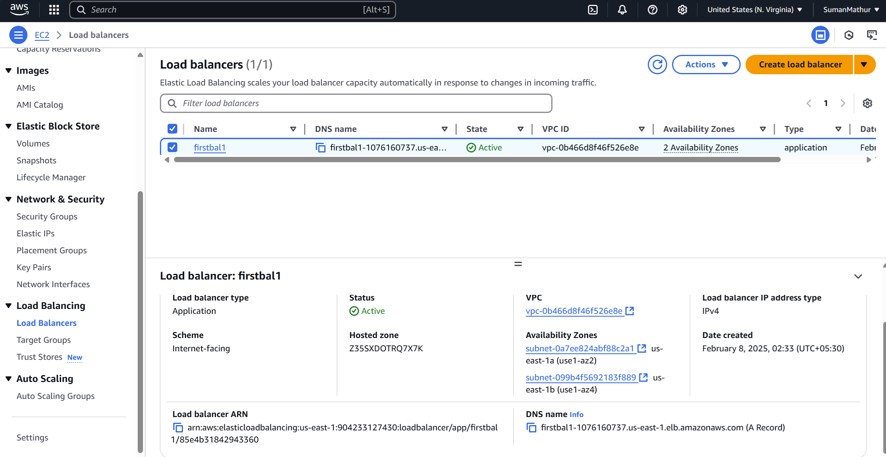
Step22: Copy DNS

Slide 24
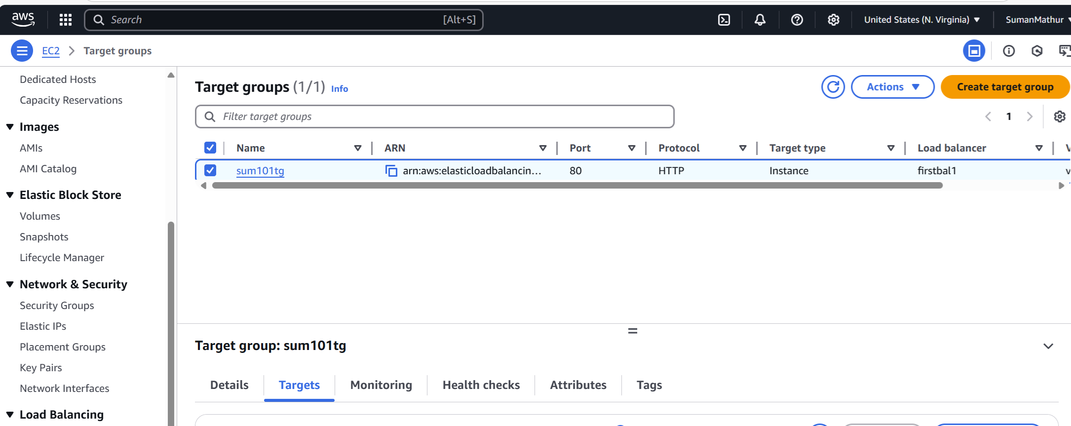
Step23: EC2dashboard – Loadbalancer – Target Group ----- Select target

Slide 25
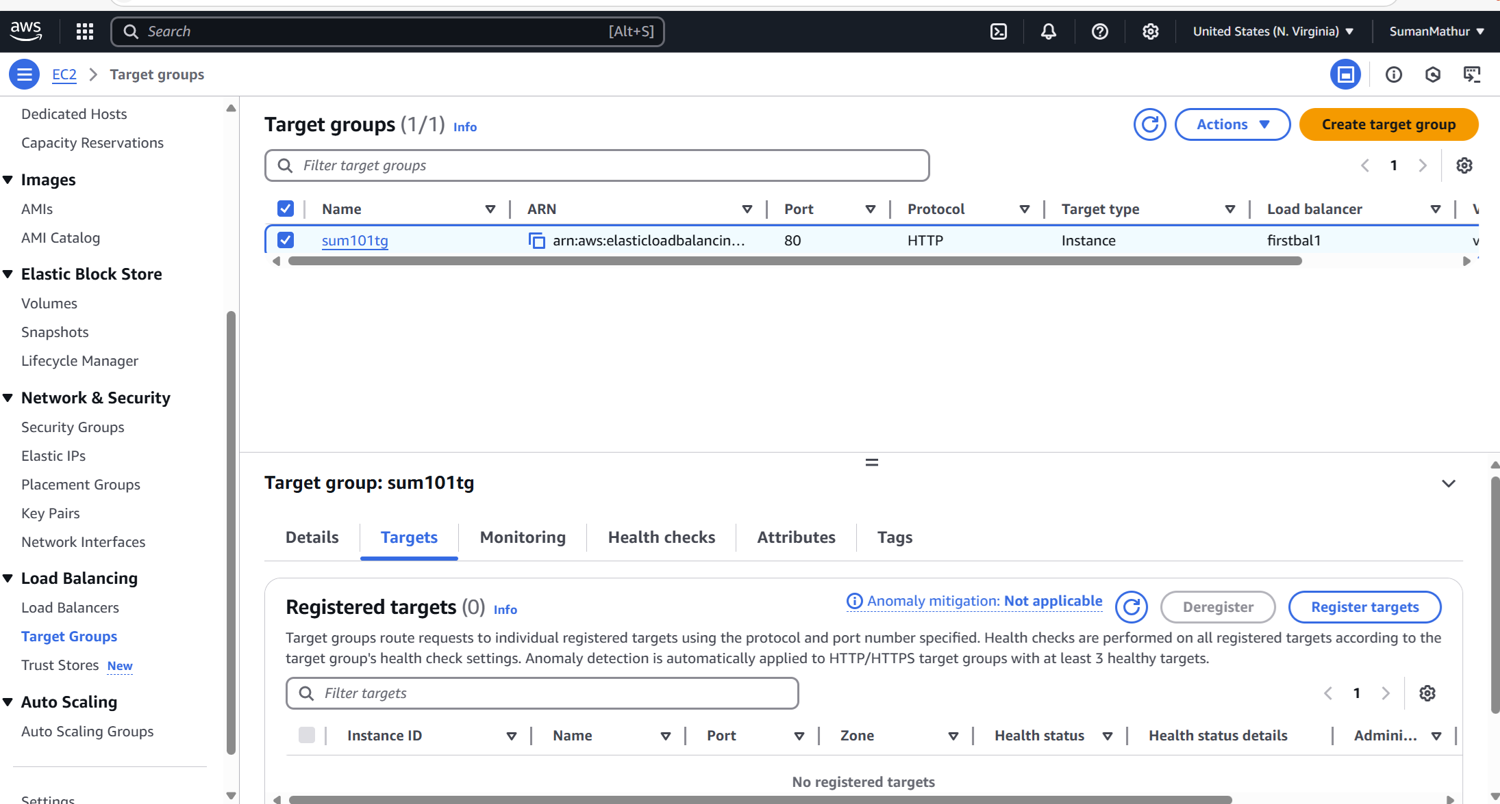
Step 25: Click on Registry targets

Slide 26
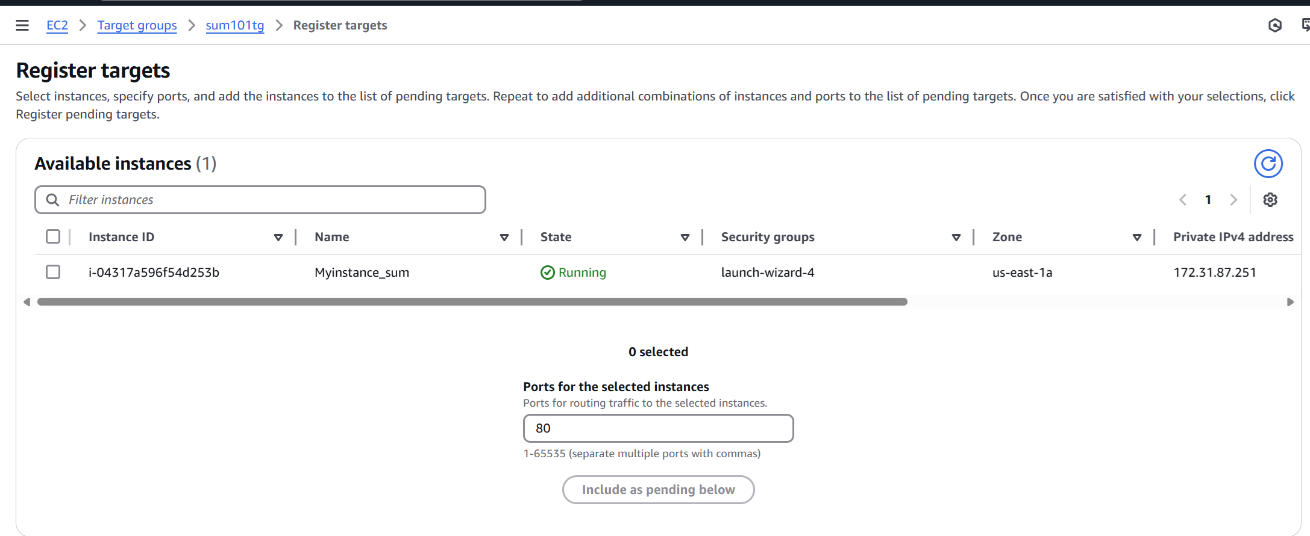
Step 26: Select instance and click on pending below

Slide 27
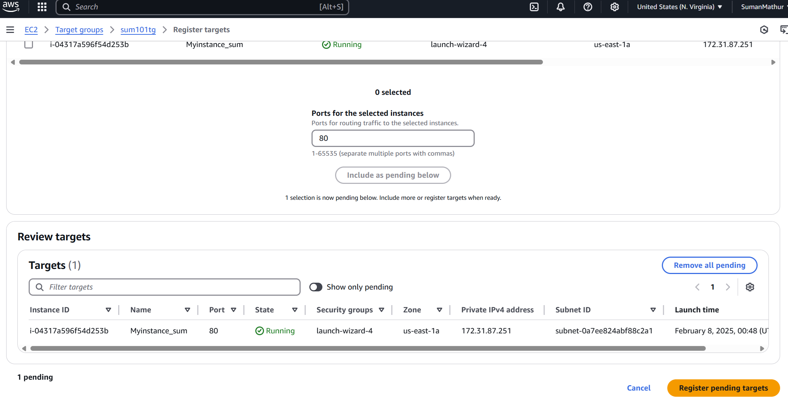
Step 27: Select Register pending targets

Slide 28
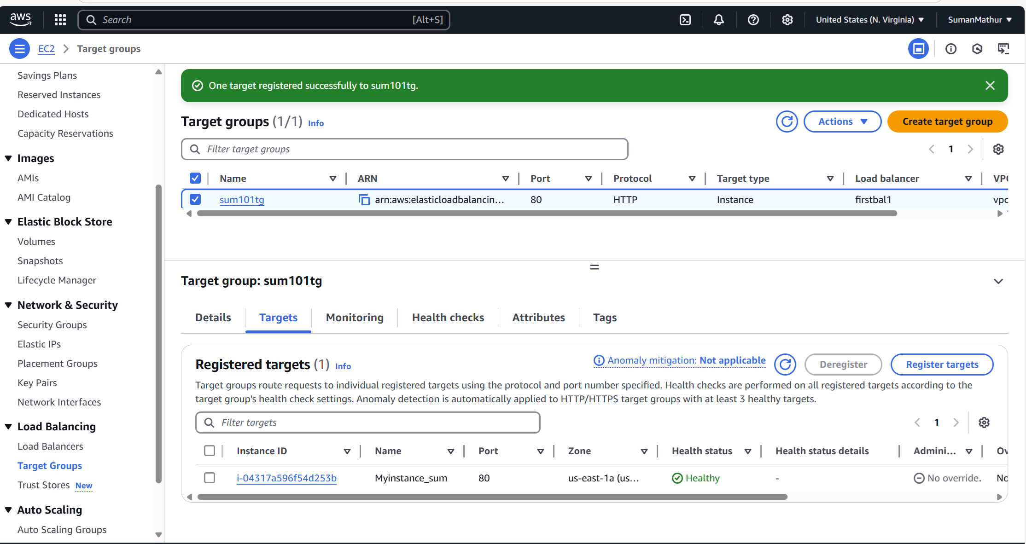
Step 2: Successfully registered
sum101tg now has 1 Healthy target and 0 Unhealthy targets. It means Load Balancer (firstbal1) can now properly route traffic to your EC2 instance.

Slide 29

Successfully Established

